Slide 1

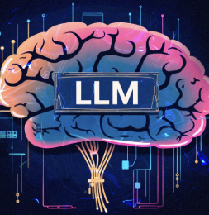
LLM TUTORIAL
AI 395T – AI IN HEALTHCARE ROSHNI VENKAT

Slide 2
HEALTHCARE ISSUE
Predict if a COVID-19 patient needs to be hospitalized
We have seen several patients with COVID-19 symptoms who don’t realize the severity until it is too late.
This could have been prevented if they were hospitalized.
In this project, I build a predictor that tells if a patient needs to be hospitalized based on their observations and conditions.
It will help doctors better understand which patients to admit and the symptoms they need to look out for.

Slide 3
MEDICAL DATASET USED
I used the 10k synthesized COVID-19 data provided in the assignment instructions
Link to dataset: https://mitre.box.com/shared/static/9iglv8kbs1pfi7z8phjl9sbpjk08spze.zipLinks to an external site.
From this dataset, the following tables are made used of:
conditions.csv: used to get patient conditions like fever, sore throat, cough etc.
observations.csv: used to get patient vitals like heart rate, breathing rate, oxygen saturation etc.
encounters.csv: used to get the hospitalization target field. The encounter types “inpatient” and “emergency” indicate hospitalization

Slide 4
METHODS EMPLOYED – SHOT LEARNING
I used zero-shot, one-shot and two-shot learning to see whether ChatGPT would be successful in predicting whether the patient requires hospitalization

Slide 5
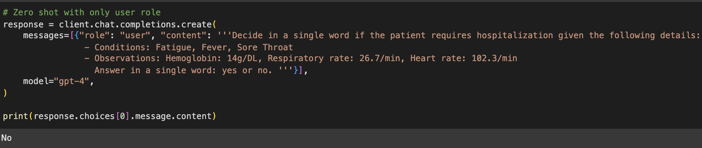
ZERO-SHOT LEARNING
I engineered prompts to predict my target variable: whether the patient requires hospitalization
Some of the features I included in my prompts were the patient’s symptoms like fever, sore throat and fatigue, and their vitals: heart rate, respiratory rate and hemoglobin level
First, I started with this prompt using only the user role

Slide 6
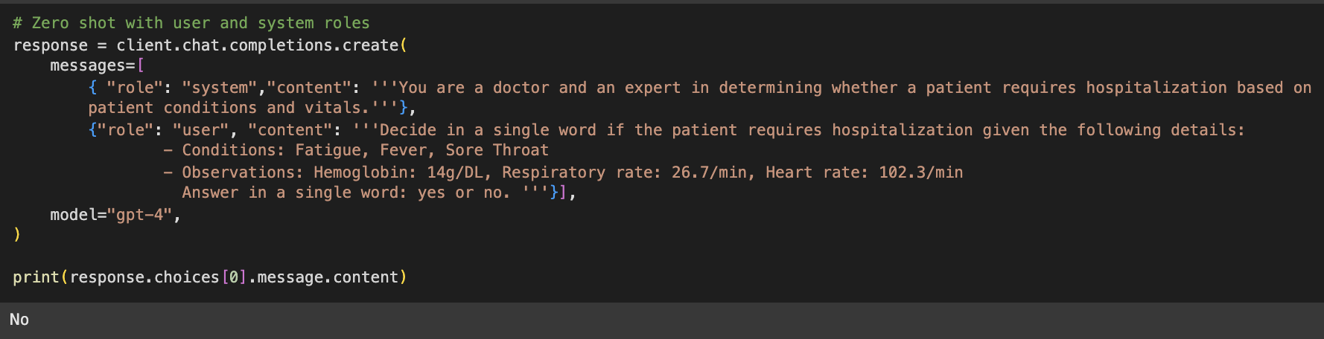
ZERO-SHOT LEARNING
It returned the wrong prediction
Then I tried the same prompt with a system role as well: “You are a doctor and an expert in determining whether a patient requires hospitalization based on patient condition and vitals.”
This also gave me the wrong prediction. I decided to try the same prompt with one-shot and two-shot learning

Slide 7
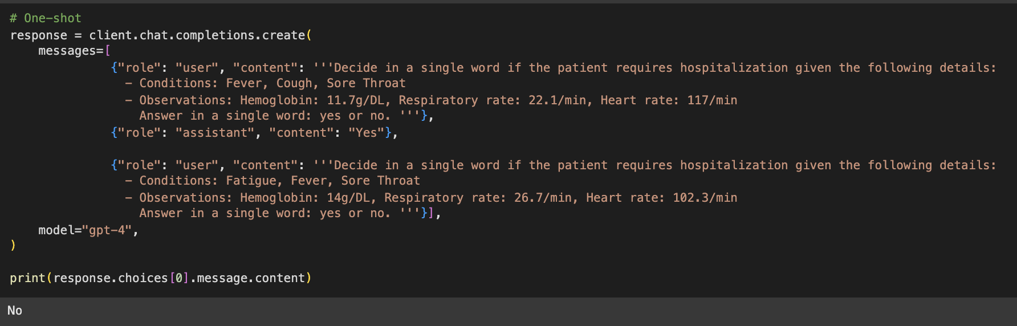
ONE-SHOT LEARNING
In one-shot learning, I give an example of a patient with similar vitals and conditions that returns “yes” for hospitalization
Fever and fatigue remained the same, but they were experiencing cough instead of a sore throat
Their vitals are also identical and in the same range
However, ChatGPT still gave the wrong prediction

Slide 8
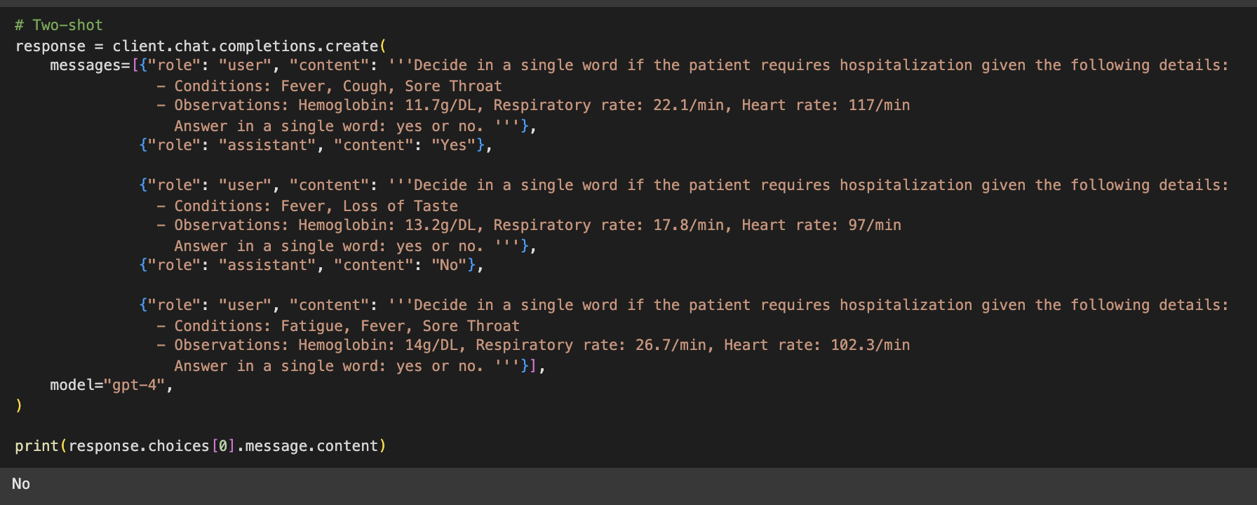
TWO-SHOT LEARNING
I give examples of two patients with one of them requiring hospitalization and the other one not requiring hospitalization
The patient with similar conditions and vitals requires hospitalization
Surprisingly, this did not yield the right answer either

Slide 9
METHODS EMPLOYED – IN-CONTEXT LEARNING
I used CHAIN-OF-THOUGHT and Tree-of-thought learning to see whether ChatGPT would be successful in predicting whether the patient requires hospitalization

Slide 10
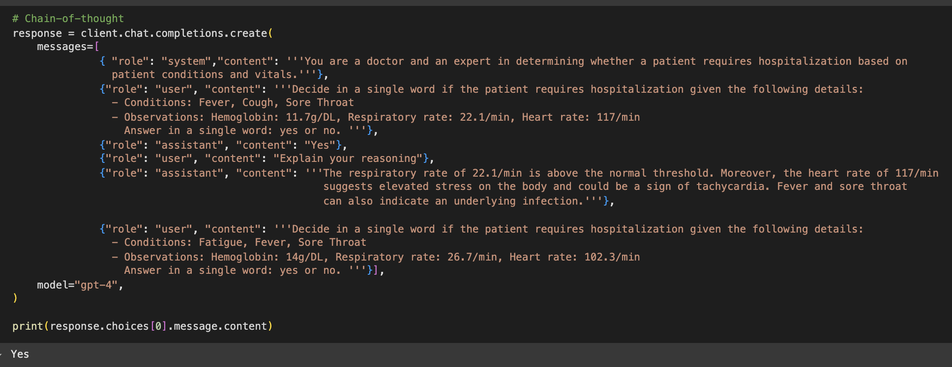
CHAIN-OF-THOUGHT
In chain-of-thought, I use both the user and system roles.
I give a clear explanation of the reasoning behind why the other patient with similar conditions and vitals requires hospitalization
This worked and ChatGPT finally gave the correct output

Slide 11
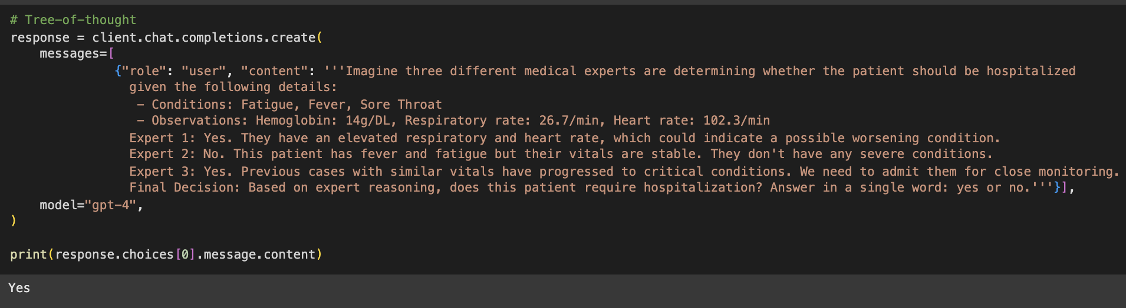
TREE-OF-THOUGHT
In tree-of-thought, I create three hypothetical medical experts to evaluate whether the patient requires hospitalization
I explain why each expert believes that the patient requires/does not require hospitalization
I ask the model to make the final decision after hearing the input from the medical experts
This method also proved to be successful with the model returning the correct output

Slide 12
EVALUATION
The shot-based learning methods (zero-shot, one-shot, two-shot) returned incorrect predictions, whereas the in-context learning methods (chain-of-thought and tree-of-thought) produced the correct prediction.
The key difference between these approaches was that reasoning and step-by-step logical explanations were explicitly incorporated in chain-of-thought and tree-of-thought methods. While one-shot and two-shot learning provided similar examples, they lacked explanations, leading to incorrect predictions. This highlights that just providing examples is not always sufficient—the model benefits from a clear breakdown of reasoning to reach the right decision.
This experiment illustrates that reasoning and logic play a crucial role in effective prompting. The more explanation and information given in the prompt, the more accurate the model's response becomes.

Slide 13
POSSIBLE IMPROVEMENTS
I was quite impressed with ChatGPT’s predictions and the quality of responses generated. However, achieving the correct prediction was not straightforward—I had to experiment with multiple reasoning techniques and in-context learning approaches before coming to the correct prediction
By analyzing chain-of-thought and tree-of-thought learning methods, I realized that simply presenting a dataset or examples is not enough. The model performs significantly better when given explicit reasoning steps or when multiple perspectives (tree-of-thought) are considered.
Moving forward, I can improve predictions by:
Using step-by-step explanations along with in-context examples.
Refining prompt engineering: Testing variations that provide reasoning and ranking of severity
Providing decision trees with an explanation of each possible route

Slide 14
BONUS: CHATGPT EMBEDDINGS FOR HOSPITALIZATION PREDICTION

Slide 15
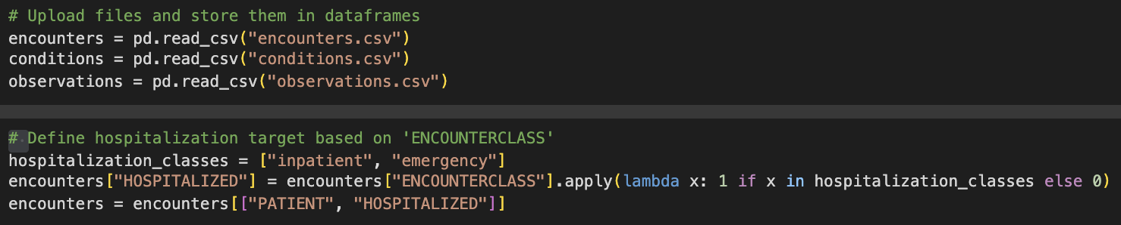
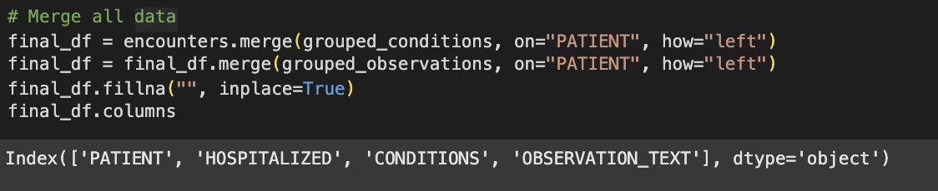
DATA FILTERING AND PROCESSING
Upload files from local
Define the target column (hospitalization) based on the encounter class
Merge all three tables: evaluations, conditions and observations on the patient column

Slide 16
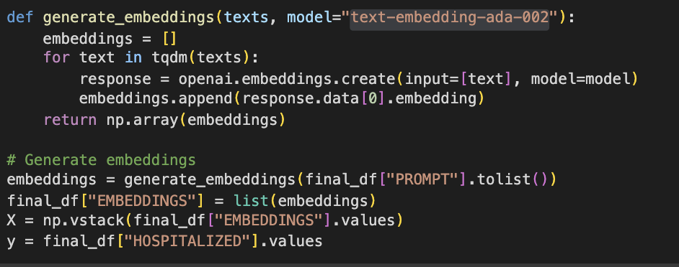
GENERATE EMBEDDINGS
Use OpenAI’s model “text-embedding-ada-002” to generate embeddings for the train dataset
Next, we will use the embeddings as input to a Random Forest Classifier for hospitalization prediction

Slide 17
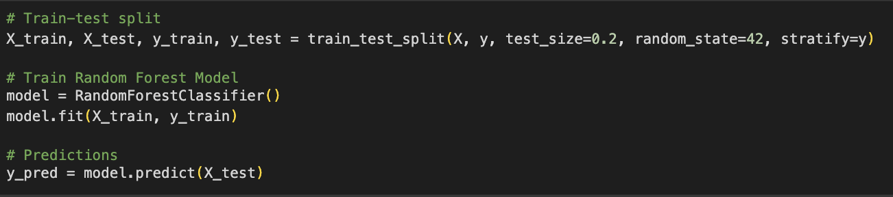
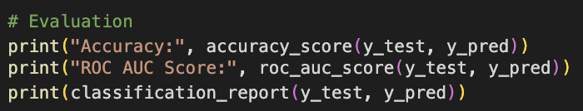
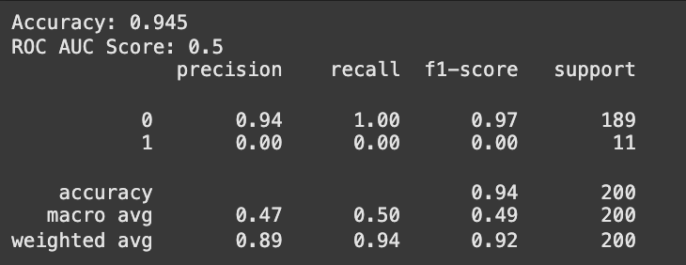
RANDOM FOREST CLASSIFICATION
Split the dataset for training and testing (80-20 split)
Use random forest classifier to train the model using embeddings generated by ChatGPT
Testing this model on the test data gives an accuracy of 94.5%

